Slide 1
Regularization. Transfer Learning. Data Augmentation
Radu Ionescu, Prof. PhD.
raducu.ionescu@gmail.com
Faculty of Mathematics and Computer Science
University of Bucharest

Slide 2
Regularization
Srivastava et al. “Dropout: A simple way to prevent neural networks from overfitting”. JMLR 2014.
Wan et al. “Regularization of neural networks using dropconnect”. ICML 2013.
Goodfellow et al. “Maxout networks”. ICML 2013.

Slide 3
Training Data
$$x_{2}$$
$$x_{1}$$

Slide 4
Training Data
$$x_{2}$$
$$x_{1}$$

Slide 5
Regularization: L1 vs. L2

Slide 6
Sparsity (L1)
$$x_{2}$$
$$x_{1}$$

Slide 7
Optimal Hyperplane (L2)
$$d$$
$$d$$
$$x_{2}$$
$$d$$
$$x_{1}$$

Slide 8
Optimal Neural Net?
$$x_{2}$$
$$x_{1}$$
Notes:
Note that with back propagation, you can compute and add the gradient of L1 or L2 norm. But they’re not enough to prevent overfitting.
For neural nets people do things like early stopping, to have a validation set, and if you see validation error increases you stop training.

Slide 9
Optimal Neural Net?
$$L2: \frac{dL}{dW}+r W$$
$$L1: \frac{dL}{dW}+r sign(W)$$
$$x_{2}$$
$$x_{1}$$
Notes:
Note that with back propagation, you can compute and add the gradient of L1 or L2 norm. But they’re not enough to prevent overfitting.
For neural nets people do things like early stopping, to have a validation set, and if you see validation error increases you stop training.

Slide 10
Bayesian Prediction?
$$p(θ_{2}|train)$$
$$p(θ_{1}|train)$$
$$x_{2}$$
?
$$x_{1}$$

Slide 11
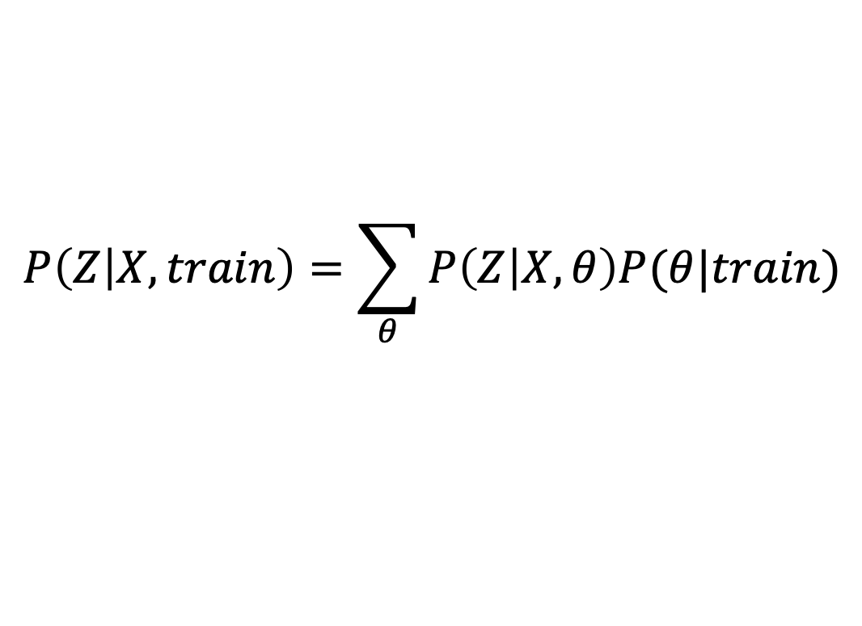
Bayesian Prediction?
$$p(θ_{2}|train)$$
$$p(θ_{1}|train)$$
$$x_{2}$$
?
$$P\left(Z | X,train\right)=\sum_{θ}{P\left(Z | X,θ\right)P(θ|train)}$$
$$x_{1}$$

Slide 12
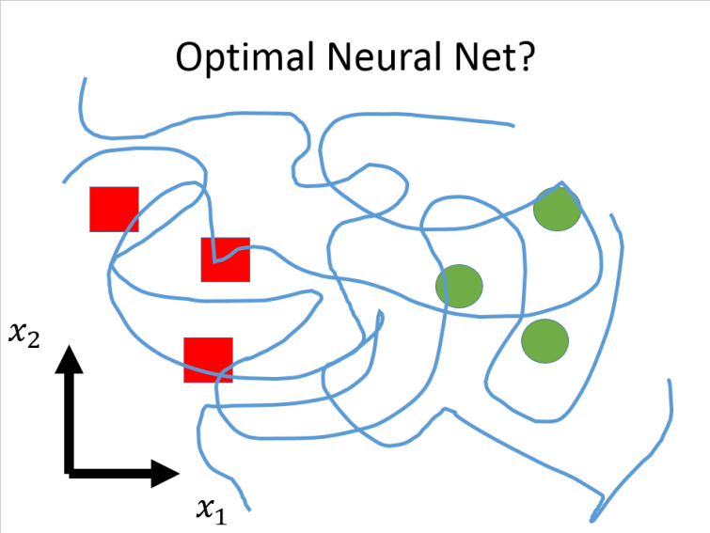
Regularization
How to select a good model?
How to regularize neural nets?
Notes:
These are two main problems regularization tries to address.

Slide 13
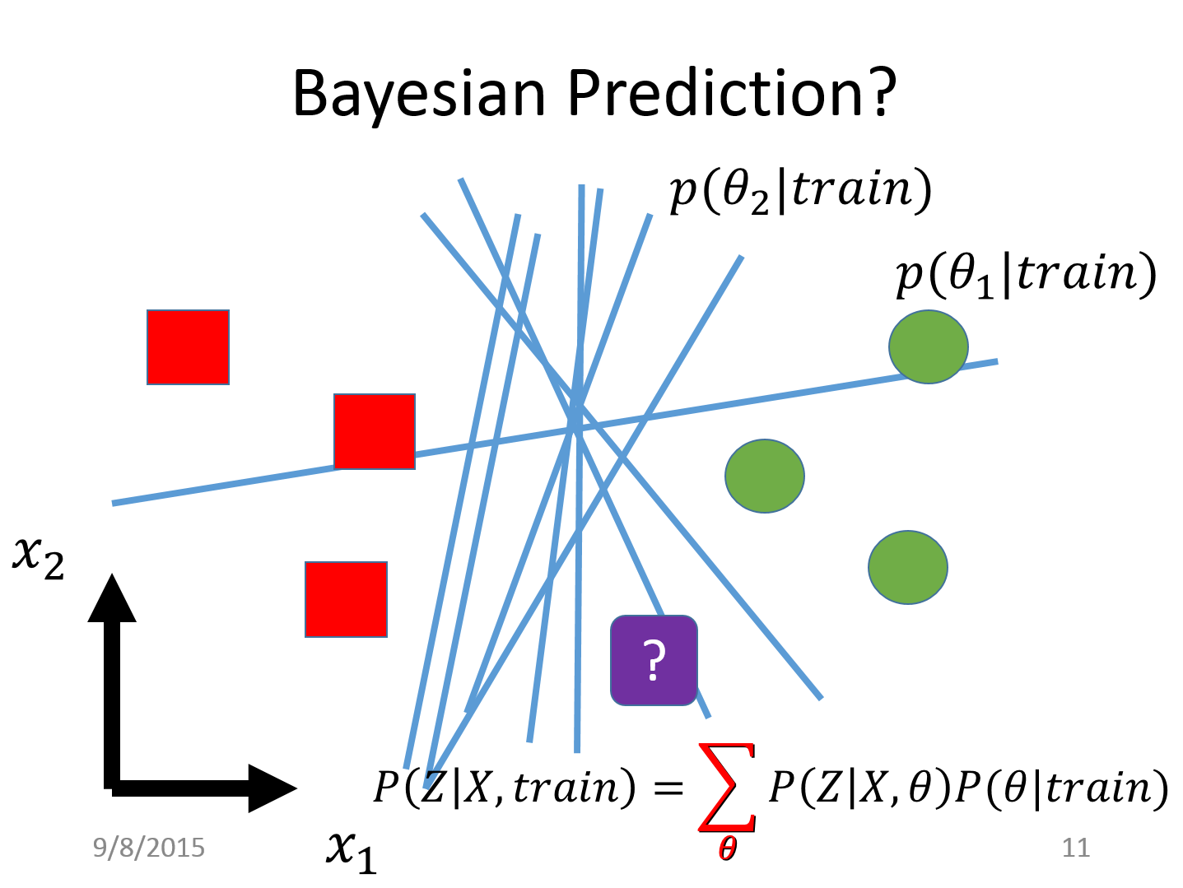
Regularization
How to select a good model?
How to regularize neural nets?
How to make a good prediction?
How to approximately vote over all models?
Notes:
These are two main problems regularization tries to address.

Slide 14
Regularization
How to select a good model?
How to regularize neural nets?
How to make a good prediction?
How to approximately vote over all models?
Dropout
Dropout
Notes:
The paper we read today, dropout provides solutions to both sides

Slide 15
Dropout in ILSVRC 2010
ImageNet Large Scale Visual Recognition Challenge (ILSVRC)
1.2 million images over 1000 categories
Report top-1 and top-5 error rate
Notes:
In the success of neural nets in ImageNet challenge
dropout plays an important role
We learned in the last class about the Imagenet challenge, and how alex krizhevsky beats previous approaches by 8%.

Slide 16
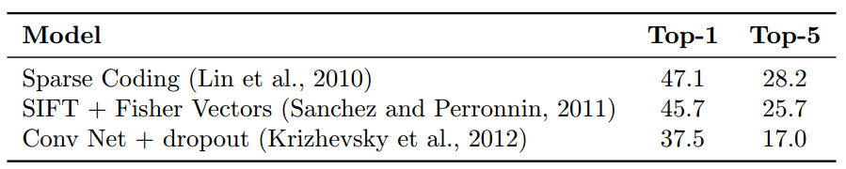
Dropout in ILSVRC 2010
ImageNet Large Scale Visual Recognition Challenge (ILSVRC)
1.2 million images over 1000 categories
Report top-1 and top-5 error rate
Notes:
In the success of neural nets in ImageNet challenge
dropout plays an important role
We learned in the last class about the Imagenet challenge, and how alex krizhevsky beats previous approaches by 8%.

Slide 17
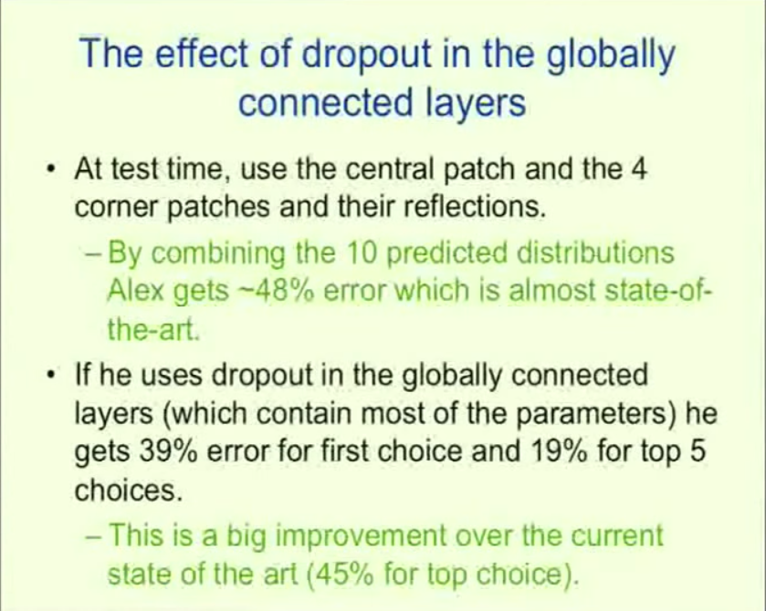
Dropout in ILSVRC 2010
Notes:
A very interesting point is here, that before using dropout, Alex gets ~48% top 1 error which does not even beat the previous approaches. But with dropout in fully connected layers, he gets 39% error, a huge 9% improvement and 19% top-5 error rate, set the state of the art by 6%.

Slide 18
Dropout in ILSVRC 2010
Notes:
Then as we know, he later also uses dropout in convolutional layers. And his performance further improves by 2%

Slide 19
What is Dropout
$$x_{1}$$
$$w_{1}$$
$$y=w_{1}x_{1}+w_{2}x_{2}$$
$$+w_{3}x_{3}+w_{4}x_{4}+b$$
$$x_{2}$$
$$w_{2}$$
$$w_{3}$$
$$x_{3}$$
$$w_{4}$$
$$x_{4}$$
$$b$$
1
Notes:
Ok so what is the magic dropout?

Slide 20
What is Dropout
During training
For each data point
Randomly set input to 0 with probability 0.5 “dropout ratio”.
$$x_{1}$$
$$w_{1}$$
$$y=w_{1}x_{1}+w_{3}x_{3}+b$$
$$0$$
$$w_{2}$$
$$w_{3}$$
$$x_{3}$$
$$w_{4}$$
$$0$$
$$b$$
1

Slide 21
What is Dropout
During training
For each data point
Randomly set input to 0 with probability 0.5 “dropout ratio”.
$$0$$
$$w_{1}$$
$$y=w_{2}x_{2}+w_{3}x_{3}+b$$
$$x_{2}$$
$$w_{2}$$
$$w_{3}$$
$$x_{3}$$
$$w_{4}$$
$$0$$
$$b$$
1

Slide 22
What is Dropout
During training
For each data point
Randomly set input to 0 with probability 0.5 “dropout ratio”.
$$x_{1}$$
$$w_{1}$$
$$y=w_{1}x_{1}+b$$
$$0$$
$$w_{2}$$
$$w_{3}$$
$$0$$
$$w_{4}$$
$$0$$
$$b$$
1

Slide 23
What is Dropout
During training
For each data point
Randomly set input to 0 with probability 0.5 “dropout ratio”.
During testing
Halve weights
No dropout
$$x_{1}$$
$$w_{1}/2$$
$$y=(w_{1}x_{1}+w_{2}x_{2}$$
$$+w_{3}x_{3}+w_{4}x_{4})/2+b$$
$$x_{2}$$
$$w_{2}/2$$
$$w_{3}/2$$
$$x_{3}$$
$$w_{4}/2$$
$$x_{4}$$
$$b$$
1
Notes:
During testing there is no dropout, but according to a theory I’ll talk about later we need to halve all weights.
And that’s all dropout do. Surprisingly simple.

Slide 24
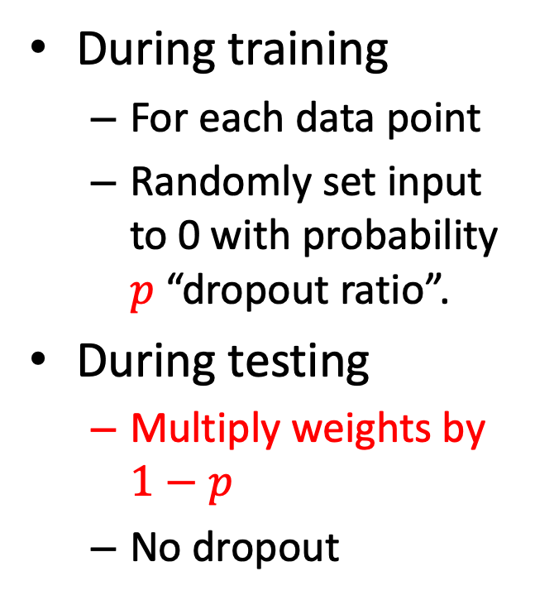
What is Dropout
During training
For each data point
Randomly set input to 0 with probability $p$ “dropout ratio”.
During testing
Multiply weights by $1−p$
No dropout
$$x_{1}$$
$$(1−p)w_{1}$$
$$y=(w_{1}x_{1}+w_{2}x_{2}$$
$$+w_{3}x_{3}+w_{4}x_{4})\left(1−p\right)$$
$$+b$$
$$x_{2}$$
$$(1−p)w_{2}$$
$$(1−p)w_{3}$$
$$x_{3}$$
$$(1−p)w_{4}$$
$$x_{4}$$
$$b$$
1
Notes:
The dropout rate is a parameter if we dropout with rate p, at test time we multiply the weights by 1-p.
This paper talks about multiplying weights,.

Slide 25
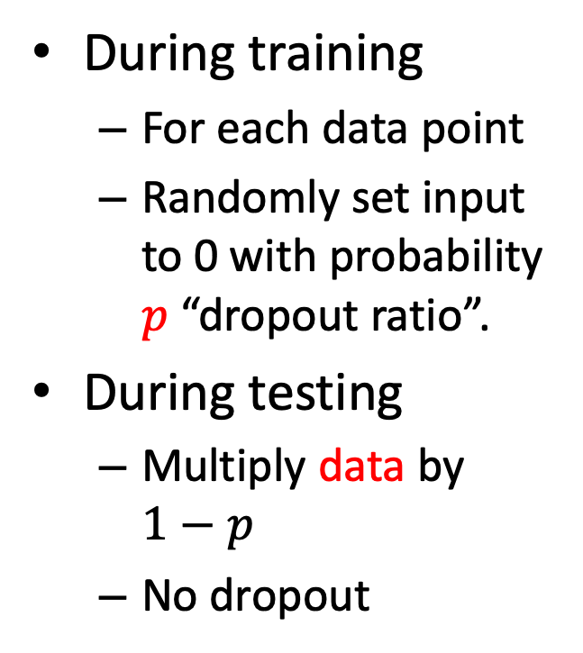
What is Dropout
During training
For each data point
Randomly set input to 0 with probability $p$ “dropout ratio”.
During testing
Multiply data by $1−p$
No dropout
$$(1−p)x_{1}$$
$$w_{1}$$
$$y=(w_{1}x_{1}+w_{2}x_{2}$$
$$+w_{3}x_{3}+w_{4}x_{4})\left(1−p\right)$$
$$+b$$
$$(1−p)x_{2}$$
$$w_{2}$$
$$(1−p)x_{3}$$
$$w_{3}$$
$$w_{4}$$
$$(1−p)x_{4}$$
$$b$$
1
Notes:
Another equivalent way to think about it is to multiplying data.
Now training and testing are all operations on data, so we can think of dropout as one layer in the neural net, as one function in a cascade.

Slide 26
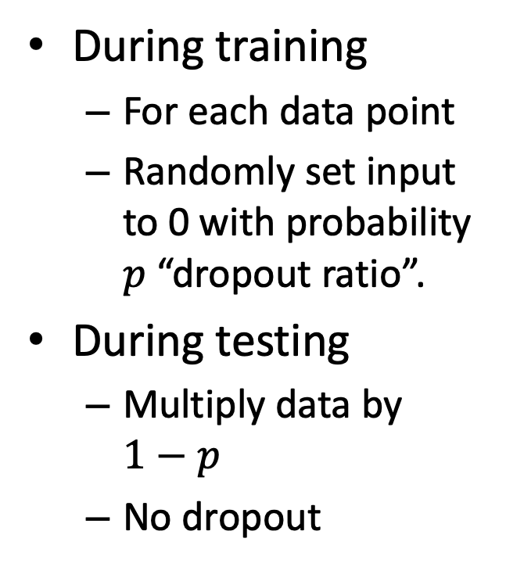
What is Dropout
Inner
Product
Layer
Dropout
“Layer”
During training
For each data point
Randomly set input to 0 with probability $p$ “dropout ratio”.
During testing
Multiply data by $1−p$
No dropout
$$X$$
$$\tilde{X}$$
$$y$$
Notes:
Training…test…

Slide 27
What is Dropout
Inner
Product
Layer
Dropout
“Layer”
During training
For each data point
Randomly set input to 0 with probability $p$ “dropout ratio”.
During testing
Multiply data by $1−p$
No dropout
$$1−p$$
$$1−p$$
$$1−p$$
$$1−p$$
$$X$$
$$\tilde{X}$$
$$y$$

Slide 28
Dropout on MLP
Without dropout
Inner Product
ReLU
Inner Product
ReLU
Inner
Product
X
Scores
Notes:
This paper shows extensive experiments on many datasets.
Insert dropout right before every inner product layer
Input dropout is not common.

Slide 29
Dropout on MLP
Without dropout
Inner Product
ReLU
Inner Product
ReLU
Inner
Product
X
Scores
With dropout
Inner
Product
ReLU
Dropout
Inner
Product
ReLU
Dropout
Inner
Product
X
Scores
Notes:
This paper shows extensive experiments on many datasets.
Insert dropout right before every inner product layer
Input dropout is not common.

Slide 30
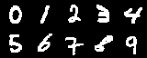
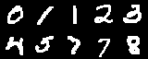
Dropout on MLP
MNIST
Classification of handwritten digits
10 classes, 60k train

Slide 31
Dropout on MLP
MNIST
Classification of handwritten digits
10 classes, 60k train
Reuters
Topic classification of documents as bags of words
50 classes, 800k train

Slide 32
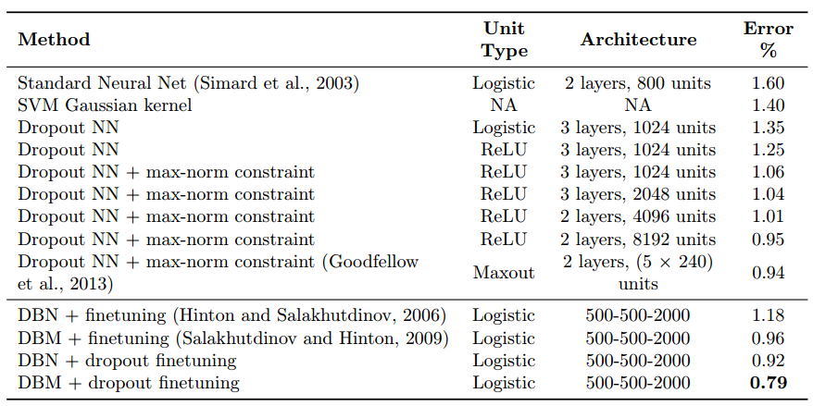
Dropout on MLP
MNIST

Slide 33
Dropout on MLP
Reuters
3 layer NN: 31.05%
3 layer NN + Dropout: 29.62%

Slide 34
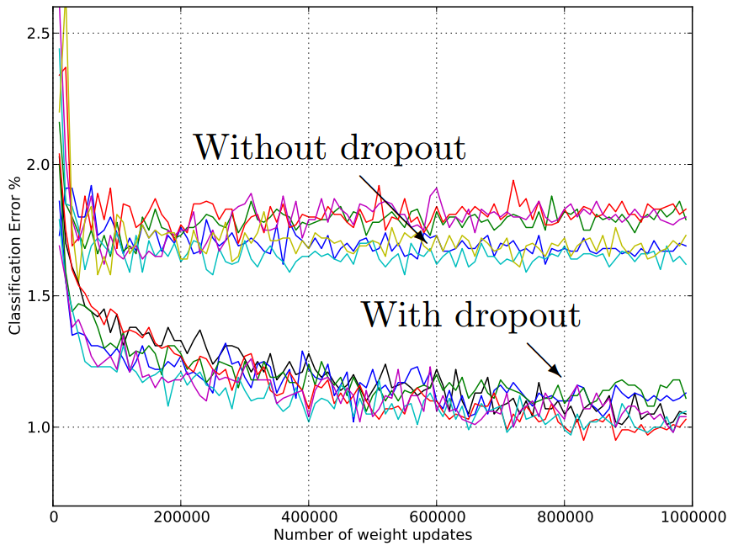
Dropout on MLP
MNIST

Slide 35
Dropout on ConvNets
Without dropout
Conv
ReLU
Conv
ReLU
Pool
Inner
Product
X
Scores

Slide 36
Dropout on ConvNets
Without dropout
Conv
ReLU
Conv
ReLU
Pool
Inner
Product
X
Scores
With dropout
Conv
ReLU
Dropout
Conv
ReLU
Pool
Dropout
Inner
Product
X
Scores

Slide 37
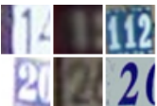
Dropout on ConvNets
Street View House Numbers (SVHN)
Color images of house numbers centered on 1 digit
10 classes, 73k train

Slide 38
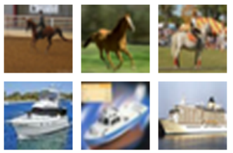
Dropout on ConvNets
Street View House Numbers (SVHN)
Color images of house numbers centered on 1 digit
10 classes, 73k train
CIFAR-10 and CIFAR-100
Color images of object categories
10/100 classes, both 50k train

Slide 39
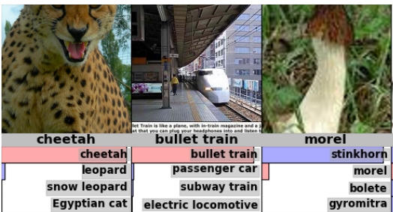
Dropout on ConvNets
Street View House Numbers (SVHN)
Color images of house numbers centered on 1 digit
10 classes, 73k train
CIFAR-10 and CIFAR-100
Color images of object categories
10/100 classes, both 50k train
ImageNet (ILSVRC series)
Color images of object categories
1000 classes, 1.2 MILLION train

Slide 40
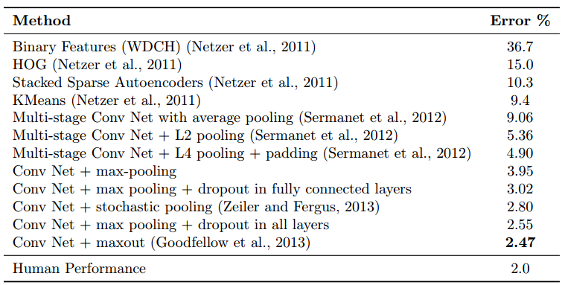
Dropout on ConvNets
Street View House Numbers (SVHN)

Slide 41
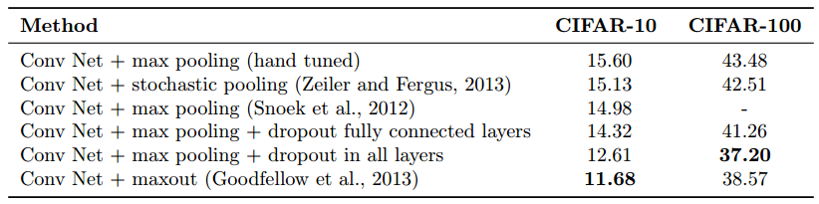
Dropout on ConvNets
CIFAR-10 and CIFAR-100

Slide 42
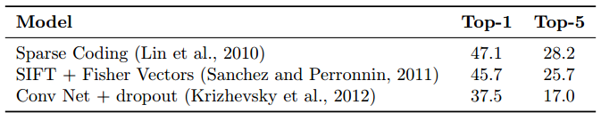
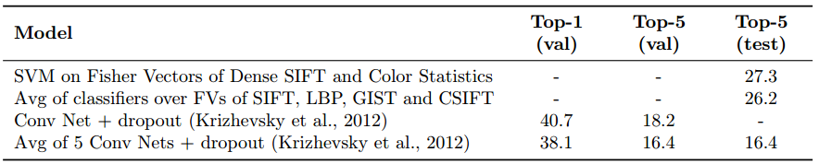
Dropout on ConvNets
ImageNet
ILSVRC 2010
ILSVRC 2012

Slide 43
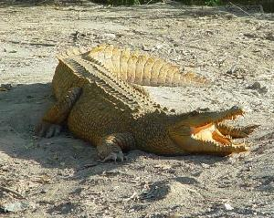
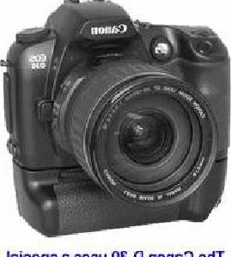
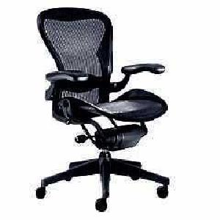
Dropout on Simple Classifiers
Caltech 101
Classifying objects into 101 categories

Slide 44
Dropout on Simple Classifiers
Caltech 101
Classifying objects into 101 categories
Deep Convolutional Activation Feature (DeCAF)
Activation of CNN (CaffeNet) layers as features

Slide 45
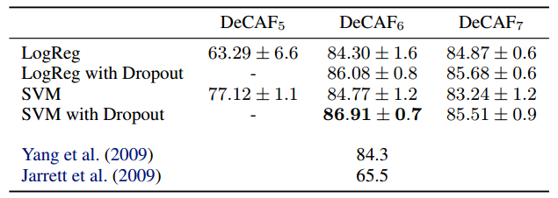
Dropout on Simple Classifiers
Caltech 101
Classifying objects into 101 categories
Deep Convolutional Activation Feature (DeCAF)
Activation of CNN (CaffeNet) layers as features
Logistic regression and SVM on DeCAF on Caltech 101

Slide 46
Why Does Dropout Work?
How to select a good model?
How to make a good prediction?
Notes:
Now we’ve seen what dropout is and how it helps deep neural networks. But why does it work so well, what’s the theory behind it.
On a side note a lot of deep learning research goes this way, you find something that works and try to explain it.
As a regularization technique dropout looks at both problems in regularization
Reach here in 15~20 mins

Slide 47
Why Does Dropout Work?
How to select a good model?
Prevent co-adaptation
Induce sparse activations
Data augmentation
How to make a good prediction?
Notes:
Now we’ve seen what dropout is and how it helps deep neural networks. But why does it work so well, what’s the theory behind it.
On a side note a lot of deep learning research goes this way, you find something that works and try to explain it.
As a regularization technique dropout looks at both problems in regularization
Reach here in 15~20 mins

Slide 48
Why Does Dropout Work?
How to select a good model?
Prevent co-adaptation
Induce sparse activations
Data augmentation
How to make a good prediction?
Bagging with shared weights
Efficient approximate averaging
Notes:
Now we’ve seen what dropout is and how it helps deep neural networks. But why does it work so well, what’s the theory behind it.
On a side note a lot of deep learning research goes this way, you find something that works and try to explain it.
As a regularization technique dropout looks at both problems in regularization
Reach here in 15~20 mins

Slide 49
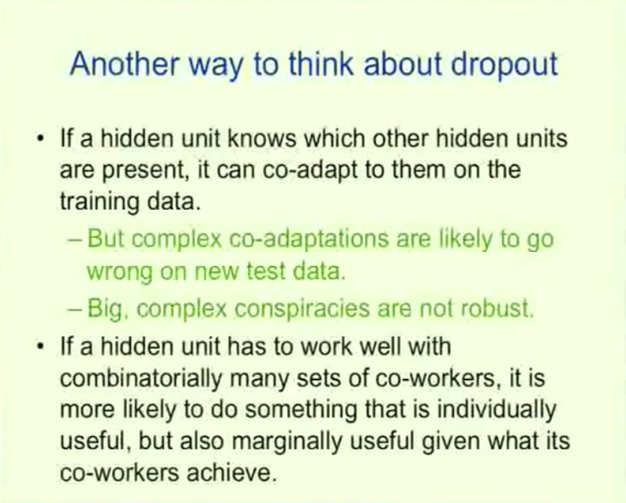
Why Does Dropout Work?
Prevent co-adaptation
Notes:
Likely to fail

Slide 50
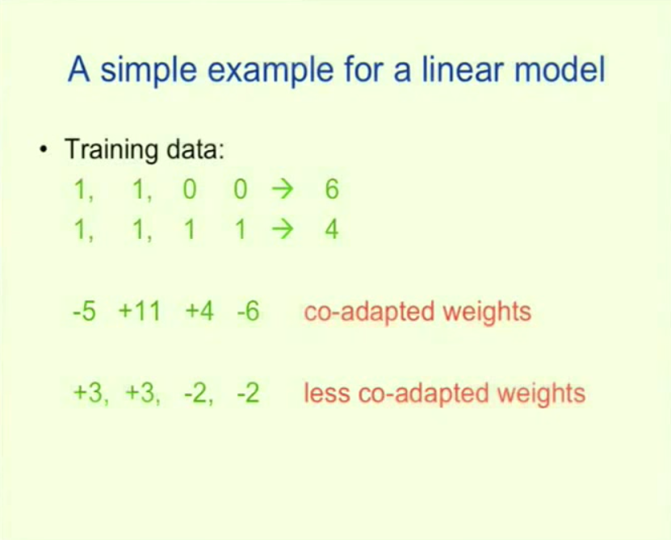
Why Does Dropout Work?
Prevent co-adaptation

Slide 51
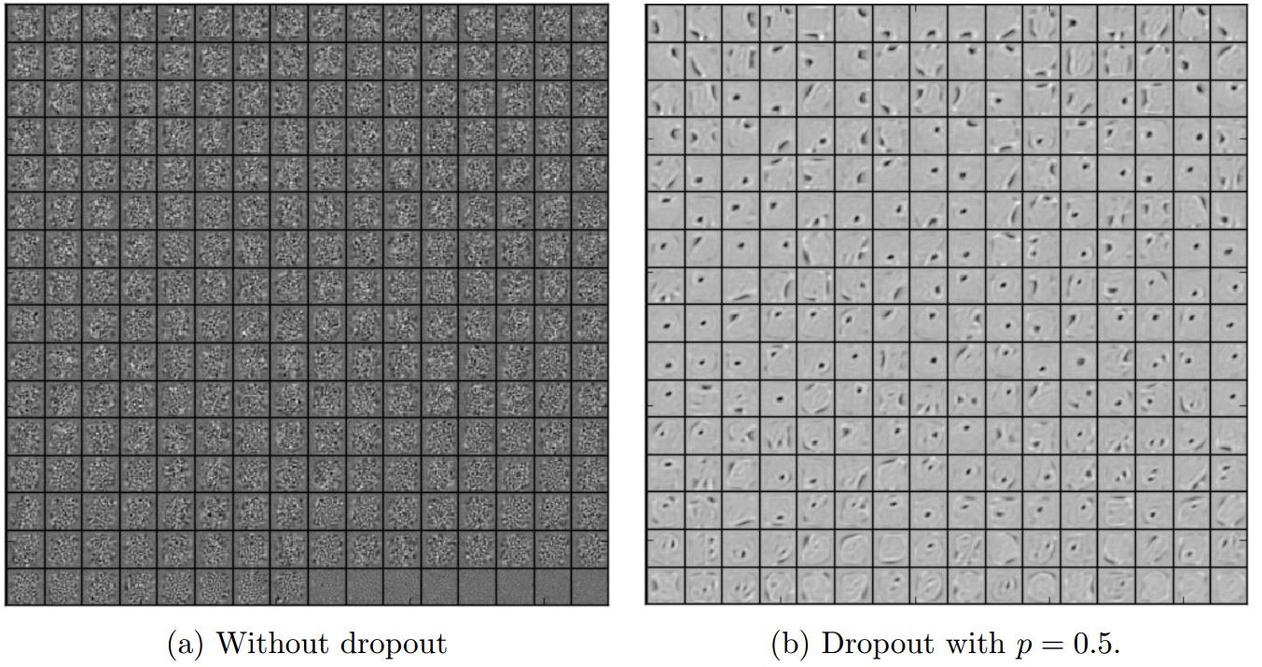
Why Does Dropout Work?
Prevent co-adaptation
Filters (autoencoder on MNIST)

Slide 52
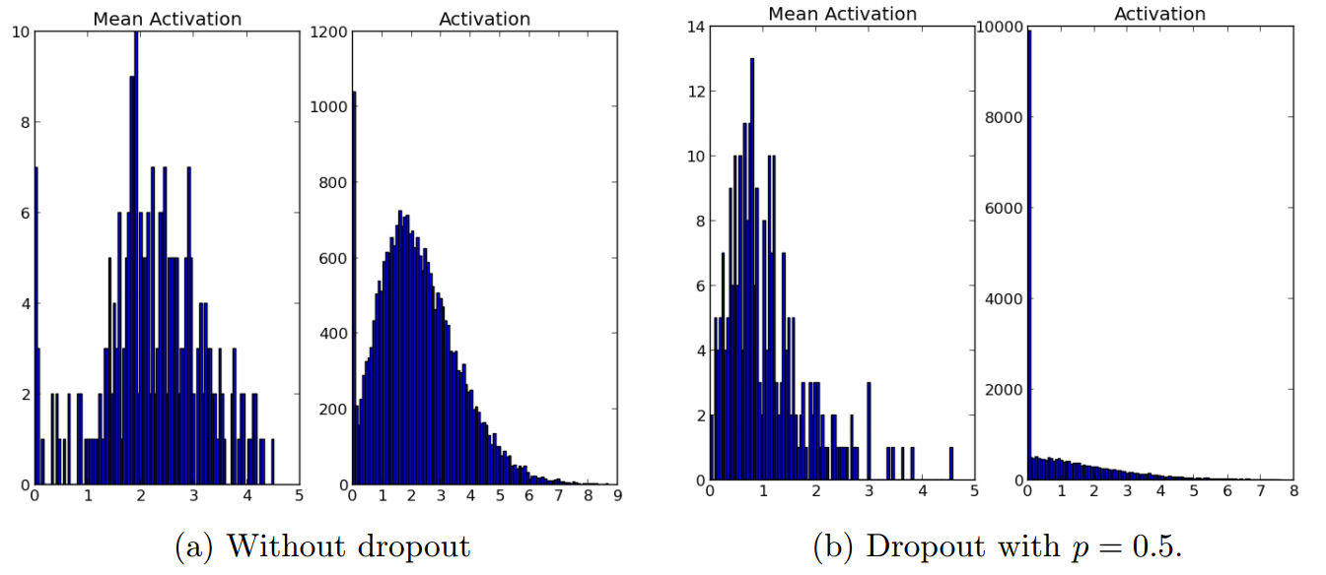
Why Does Dropout Work?
Induce sparse activations
Activations (autoencoder on MNIST)

Slide 53
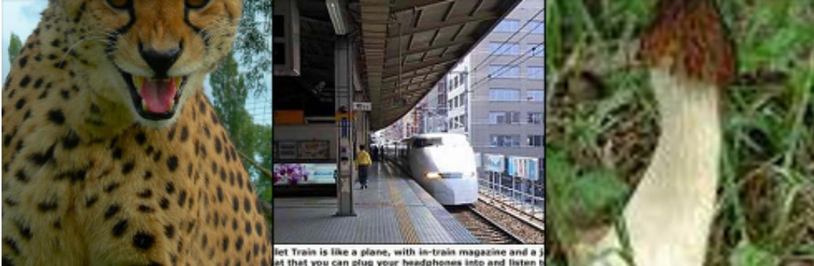
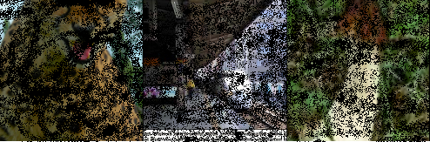
Why Does Dropout Work?
Data augmentation
Dropout as adding “pepper” noise
Cheetah
Train
Morel

Slide 54
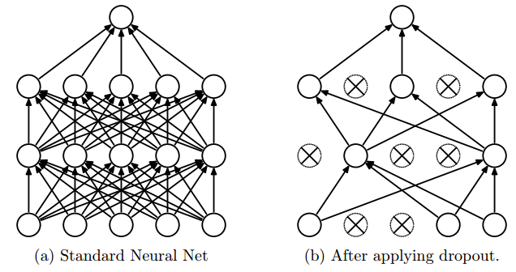
Why Does Dropout Work?
Bagging with shared weights
Exponentially many architectures
Forward
Notes:
When training, training exponentially many architectures with weights shared

Slide 55
Why Does Dropout Work?
Bagging with shared weights
Exponentially many architectures
Approximate geometric mean of all architectures
$$\tilde{x}$$
Dropout
Inner
Product
$$x$$
$$score=(w,\tilde{x})$$
$$θ$$
$$w$$
Notes:
When testing, it uses a simple approximation to compute the geometric mean of all the architectures.
With activation and more layers it’s approximate. One extension of dropout, dropconnect that peng will talk about tries to address this issue.

Slide 56
Why Does Dropout Work?
Bagging with shared weights
Exponentially many architectures
Approximate geometric mean of all architectures
$$\tilde{x}$$
Dropout
Inner
Product
$$x$$
$$score=(w,\tilde{x})$$
$$P(y|x,θ)\sim e^{(w,\tilde{x}) }$$
$$θ$$
$$w$$
Notes:
When testing, it uses a simple approximation to compute the geometric mean of all the architectures.
With activation and more layers it’s approximate. One extension of dropout, dropconnect that peng will talk about tries to address this issue.

Slide 57
Why Does Dropout Work?
Bagging with shared weights
Exponentially many architectures
Approximate geometric mean of all architectures
$$\tilde{x}$$
Dropout
Inner
Product
$$x$$
$$score=(w,\tilde{x})$$
$$P(y|x,θ)\sim e^{(w,\tilde{x}) }$$
$$θ$$
$$w$$
Geometric mean over $θ$
$$\sqrt[N]{\prod_{θ}{P(y|x,θ)}}=\sqrt[N]{\prod_{θ}{e^{(w,\tilde{x})}}}=e^{\frac{1}{N}\sum_{θ}{(w,\tilde{x})}}=e^{ ((1−p)w,x)}$$
Notes:
When testing, it uses a simple approximation to compute the geometric mean of all the architectures.
With activation and more layers it’s approximate. One extension of dropout, dropconnect that peng will talk about tries to address this issue.

Slide 58
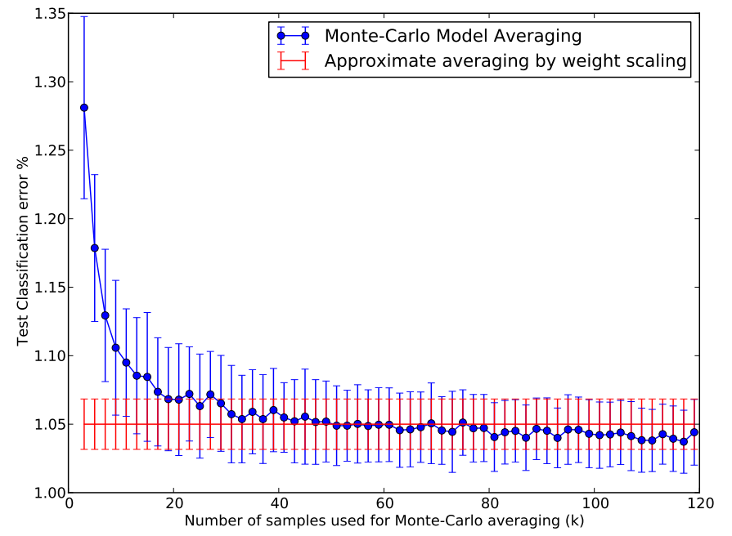
Why Does Dropout Work?
Bagging with shared weights
Exponentially many architectures
Approximate geometric mean of all architectures
Exact
Basic dropout
Notes:
But this paper also shows how well this approximation works. On MNIST they compare the (1-p) approximate averaging and sampling a bunch of architectures then average over the samples, and it shows that the dropout approximation performs well in terms of test errors.

Slide 59
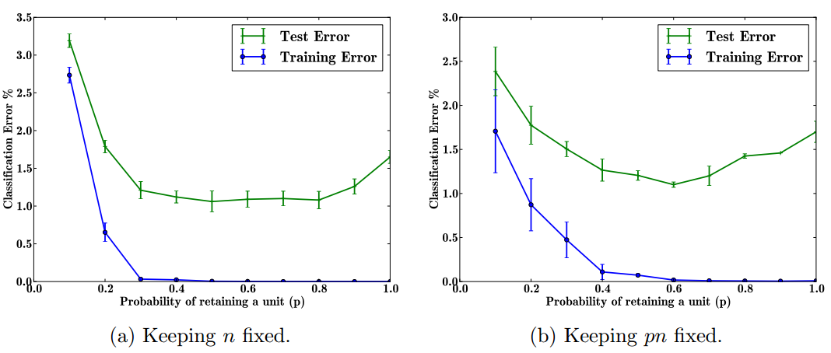
Effects of Dropout Parameters
Retaining probability (1-dropout ratio)
Notes:
For practical guidelines, this paper also studies the effect of dropout parameters.

Slide 60
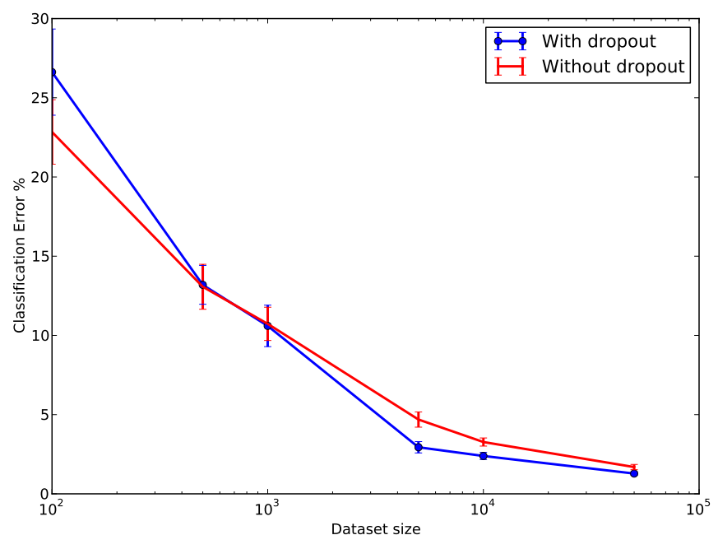
Effects of Dropout Parameters
Dataset size

Slide 61
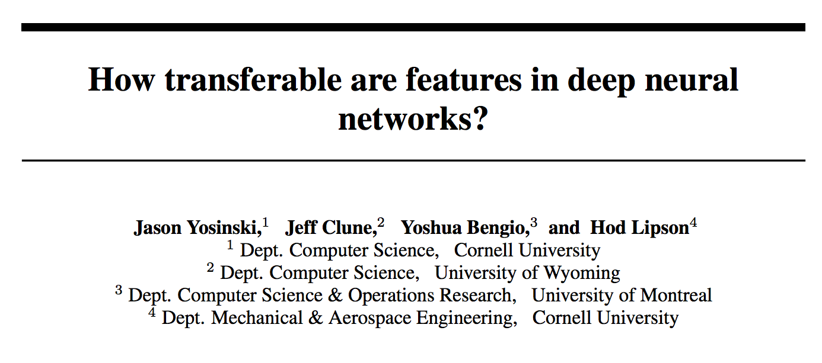
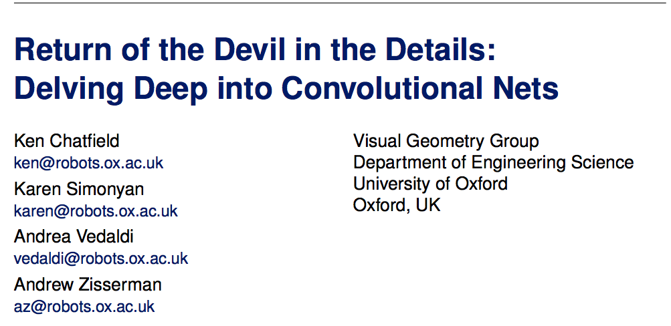
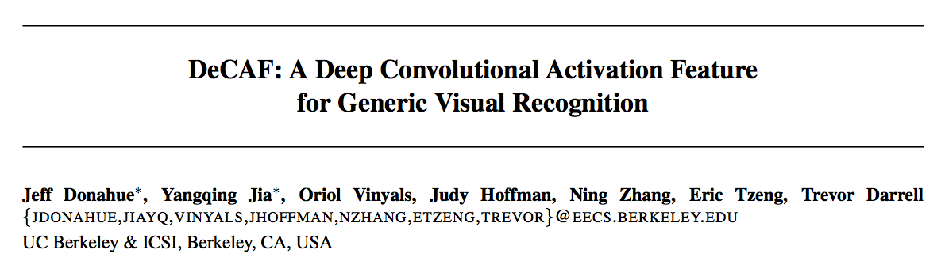
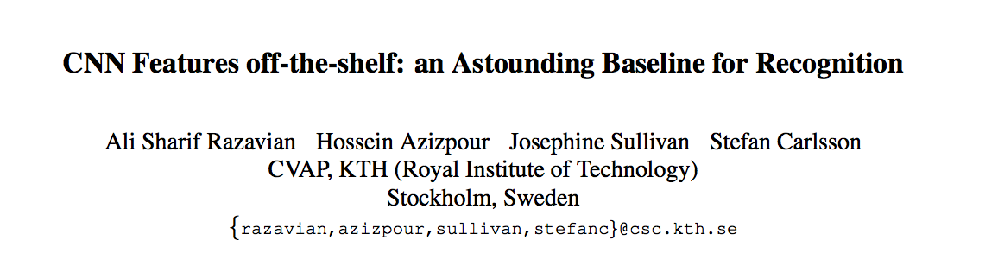
Transfer Learning

Slide 62
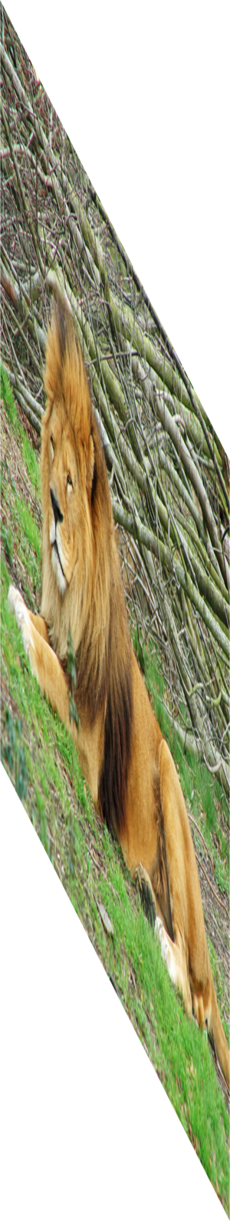
Convolutional Neural Networks: AlexNet
Lion
Image
labels
Krizhevsky, Sutskever, Hinton — NIPS 2012
Notes:
Successful training of a very large CNN on imagenet data to predict one of the thousand classes.
We know these models are working

Slide 63



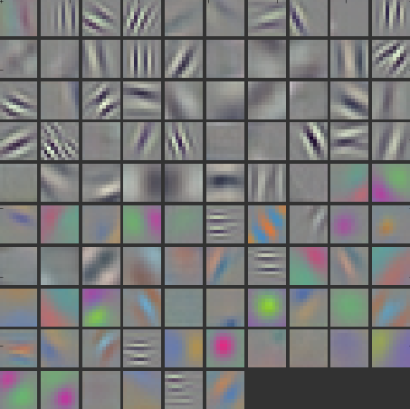
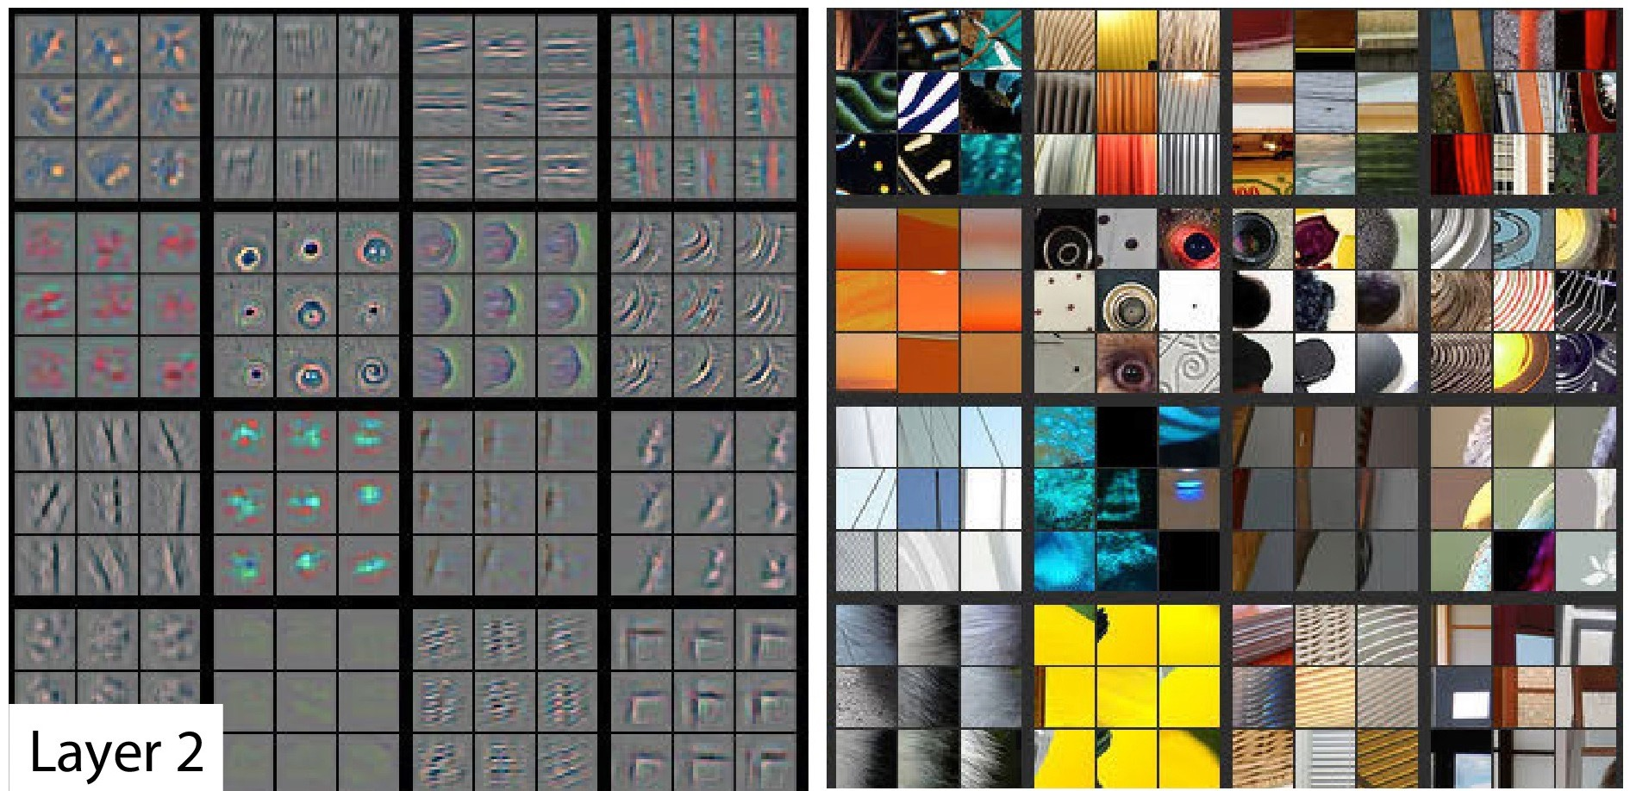
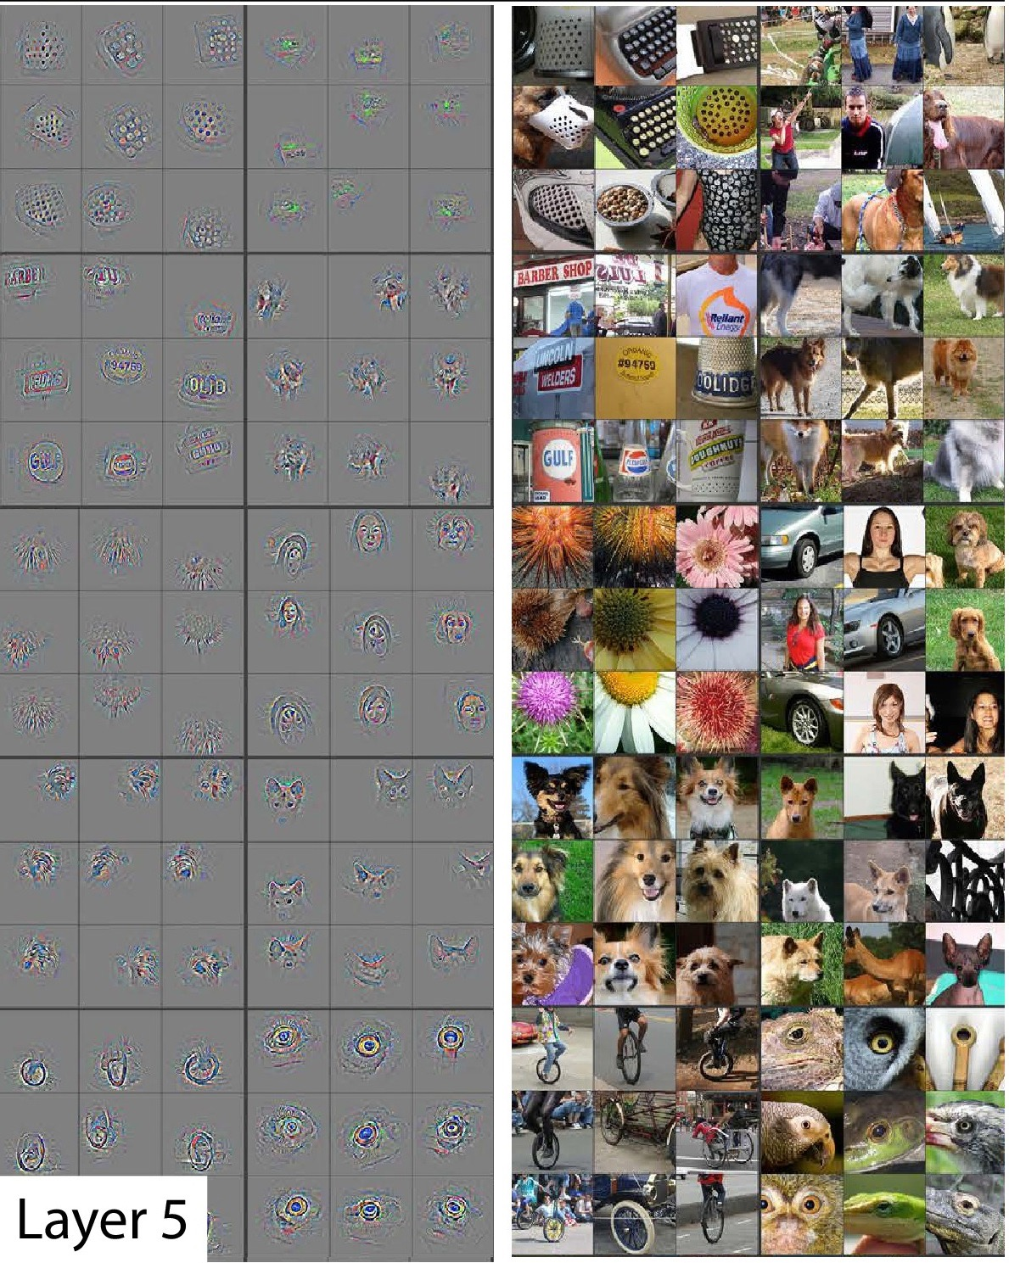
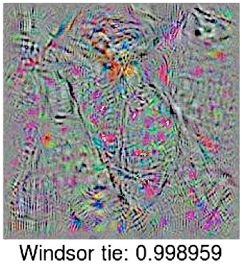
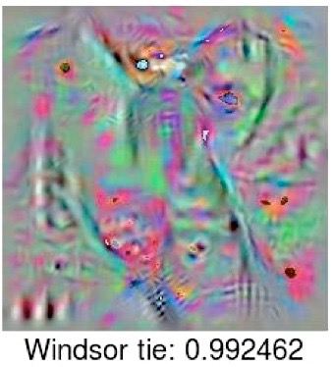
Layer 1
Filter (Gabor and color blobs)
Layer 2
Layer 5
Last
Layer
Zeiler et al.
ECCV 2014
Nguyen et al.
arXiv 2014
Gabor filter: linear filters used for edge detection with similar orientation representations to the human visual system
Notes:
clear THAT they work, but not as clear WHY or HOW.
WHAT’s going on in the middle?
LET’S think about what we DO KNOW.
It does not matter what dataset you use or what task you are training on, the first layer is always a gabor filter.
To find patches of images that cause high activation: deconvulutional neural network

Slide 64

general
Main idea of this paper:
Quantify the general to specific transition
by using transfer learning.
??
??
??
Lion
specific
Layer number
Notes:
At the beginning layers we learn features that are general. At the last layers, we learn features that are specific to the target task. The question is how this transition occurs. Quantify the transition using transfer learning. Specific to tasks,

Slide 65
Transfer Learning Overview
Input A
Task A
Layer n
Transfer
AnB: Frozen Weights
Back-propagation
Task B
Input B
Task B
Back-propagation
AnB⁺: Fine-tuning

Slide 66
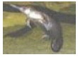
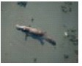
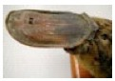
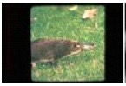
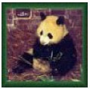
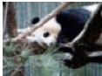
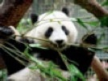








ImageNet
dataset
A
500 Classes
dataset
B
1000 Classes
500 Classes
Deng et al., 2009
Notes:
okapi

Slide 67
A Images
A Labels
500 Classes

Slide 68
A Images
A Labels
500 Classes
Notes:
train using the Caffe

Slide 69
A Images
A Labels
500 Classes

Slide 70
baseA
A Images
baseB
B Images

Slide 71

Notes:
Each point is average accuracy over validation set. Variants because of different 500 classes.

Slide 72
A Images
A Labels

Slide 73
B Images
B Labels
Hypothesis: if transferred features are specific to task A, performance drops. Otherwise the performance should be the same.

Slide 74

transfer
AnB
Compare to
B Images
B Labels
baseB

Slide 75
Notes:
When you chop half of the network, randomly initialize the rest of the network, keep the weights frozen, u have optimization issues. A so

Slide 76
B Images
B Labels

Slide 77
B Images
B Labels

Slide 78
selffer
BnB
B Images
B Labels

Slide 79


Slide 80

Performance drops due to...
Fragile
co-adaptation
Representation
specificity
Notes:
Not previously shown

Slide 81

Notes:
Not previously shown

Slide 82

Notes:
Not previously shown

Slide 83

Notes:
Not previously shown

Slide 84

Notes:
Not previously shown

Slide 85
Transfer + fine-tuning improves generalization
Notes:
Not previously shown

Slide 86
ImageNet has many related categories...
Dataset A: random
Dataset B: random
gecko
garbage truck
toucan
fire truck
radiator
binoculars
baseball
lion
panther
bookshop
rabbit
gorilla

Slide 87
ImageNet has many related categories...
Dataset A: man-made
Dataset B: natural
garbage truck
gorilla
fire truck
gecko
radiator
toucan
baseball
rabbit
binoculars
panther
bookshop
lion

Slide 88

Similar A/B

Slide 89
Similar A/B
Dissimilar A/B

Slide 90
Similar A/B
Random
(Jarret et al. 2009)
Dissimilar A/B

Slide 91
Conclusions
fine-tuning helps
co-adaptation
specificity
Measure general to specific transition layer by layer
Transferability governed by:
lost co-adaptations
specificity
difference between base and target dataset
Fine-tuning helps even on large target dataset
Notes:
In top-5 accuracy you give yourself credit for having the right answer if the right answer appears in your top five guesses.

Slide 92
DeCAF: A Deep Convolutional Activation Feature
for Generic Visual Recognition
Jeff Donahue, Yangqing Jia, Oriol Vinyals, Judy Hoffman, Ning Zhang, Eric Tzeng and Trevor Darrell
Problem:
performance with conventional visual representations had reached a plateau.
Solution:
discover effective representations that capture salient semantics for a given task.
can deep architectures do this?

Slide 93
Why Deep Models:
Deep architectures should be able to capture salient aspects of a given domain [Krizhevsky NIPS 2012], [Singh ECCV 2012]
Perform better than traditional hand-engineered representations
[Le CVPR 2011]
Had been applied to large-scale visual recognition tasks
However:
With limited training data, fully-supervised deep architectures generally overfit
Many visual recognition challenges have tasks with few training examples

Slide 94
Approach:
Train a Deep convolutional model in a fully supervised setting using Krizhevsky method and ImageNet database.
[Krizhevsky NIPS 2012]
Extract various features from the network
Evaluate the efficiency of these features on generic vision tasks
Questions:
Do features extracted from the CNN generalize the other datasets?
How does performance vary with network depth?
How does performance vary with network architecture?

Slide 95
Adopted Network:
Deep CNN architecture proposed by Krizhevsky [Krizhevsky NIPS 2012]
5 convolutional layers (with pooling and ReLU)
3 fully-connected layers
won ImageNet Large Scale Visual recognition Challenge 2012
top-1 validation error rate of 40.7%
follow architecture and training protocol with two differences
input 256 x 256 images rather than 224 x 224 images
no data augmentation trick

Slide 96
Qualitatively and Quantitatively Feedback:
Comparison with GIST features [Oliva & Torralba, 2001] and LLC features [Wang at al., 2010]
Use of t-SNE algorithm [van der Maaten & Hilton, 2008]
Use of ILSVRC-2012 validation set to avoid overfitting (150,000 photographs)
Use of SUN-397 dataset to evaluate how dataset bias affects results

Slide 97

Feature Generalization and Visualization
T-SNE Algorithm [van der Maaten & Hinton, 2008]
t-SNE feature visualizations on the ILSVRC-2012 validation set
LLC Features
GIST Features
DeCAF
LLC FEATURES
To visualize features: we run the t-SNE algorithm to find a 2-dimensional embedding of the high-dimensional feature space, and plot them as points colored depending on their semantic category in a particular hierarchy.

Slide 98



LLC FEATURES
DeCAF₁ FEATURES
GIST FEATURES
DeCAF₆ FEATURES
Notes:
- This is compatible with common deep learning knowledge that the first layers learn “low-level” features, whereas the latter layers learn semantic or “high-level” features.
- Furthermore, other features such as GIST or LLC fail to capture the semantic difference in the image

Slide 99

DeCAF₆ features trained on ILSVRC-2012 generalized to SUN-397 when considering semantic groupings of labels
SUN-397: Large-scale scene recognition from abbey to zoo.
(899 categories and 130,519 images)

Slide 100


Computational Time
Break-down of the computation time analyzed using the decaf framework.
The convolution and fully-connected layers take most of the time to run, which is understandable as they involve large matrix-matrix multiplications.

Slide 101
Experimental Comparison Feedback
No evaluation of features from any earlier layers in the CNN
do not contain rich semantic representation
Results on multiple datasets to evaluate the strength of DeCAF for
basic object recognition (Caltech-101)
domain adaptation (Office)
fine-grained recognition (Caltech-UCSD)
scene recognition (SUN-397)

Slide 102

Experiments: Object Recognition
Caltech-101
Compared also with the two-layers convolutional network of Jarret et al (2009)

Slide 103
Experiments: Domain Adaptation
Office dataset [Saenko et al., 2010], which has 3 domains:
Amazon: images taken from amazon.com
Webcam and DSLR: images taken in office environment using a webcam or SLR camera
Notes:
The dataset contains three domains: Amazon, which consists of product images taken from amazon.com; and Webcam and Dslr, which consists of images taken in an office environment using a webcam or digital SLR camera, respectively.

Slide 104


Experiments: Domain Adaptation
DeCAF robust to resolution changes
DeCAF provides better category clustering than SURF
DeCAF clusters same category instances across domains
DeCAF₆ FEATURES
GIST FEATURES

Slide 105



Experiments: Subcategory Recognition
Fine grained recognition involves recognizing subclasses of the same object class such as different bird species, dog breeds, flower types, etc.
Caltech-UCSD birds dataset
First adopt ImageNet-like pipeline, DeCAF6 and a multi-class logistic regression
Second adopt deformable part descriptors (DPD) method [Zhang et al., 2013]

Slide 106
Experiments: Scene Recognition
Goal: classify the scene of the entire image
SUN-397 large-scale scene recognition database
Outperforms Xiao ed al. (2010), the current state-of-the-art method
DeCAF demonstrates:
the ability to generalize to other tasks
- representational power as compared to traditional hand-engineered features

Slide 107

Could the features extracted by a deep network be exploited for a wide variety of vision tasks?
CNN representation replaces pipelines of service-oriented architecture (state-of-the-art) methods and achieve better results.

Slide 108
OverFeat: publicly available trained CNN, with a structure that follows Krizhevsky et al. (2012).
Trained for image classification of ImageNet ILSVRC 2013
(1.2 million images, 1000 categories).
The features extracted from the OverFeat network were used as a generic image representation
The CNN features used are trained only using ImageNet data, while the simple classifiers are trained using images specific to the task’s dataset.

Slide 109


Slide 110
Experimental Comparison Feedback
Results on multiple different recognition tasks:
visual classification (Pascal VOC 2007, MIT-67 )
fine-grained recognition (Caltech-UCSD, Oxford 102)
attribute detection (UIUC 64, H3D dataset)
visual image retrieval (Oxford5k, Paris6k, Sculptures6k, Holidays and Ukbench)

Slide 111
Visual Classification
The feature vector is L2 normalized to unit length for all the experiments.
The 4096 dimensional feature vector was used in combination with a Support Vector Machine (SVM) to solve different classification tasks (CNN-SVM).
The training set was augmented by adding cropped and rotated samples (CNNaug+ SVM).

Slide 112
Visual Classification
Databases:
Pascal VOC 2007 for object image classification. Pascal VOC 2007 contains 10000 images of 20 classes including animals, handmade and natural objects.
MIT-67 indoor scenes for scene recognition. The MIT scenes dataset has 15620
images of 67 indoor scene classes.
In contrast to object detection, object image classification requires no localization of the objects.

Slide 113
Visual Classification
Pascal VOC 2007 Image Classification Results compared to other methods which also use training data outside VOC. The CNN representation is not tuned for the Pascal VOC dataset

Slide 114

Visual Classification
Evolution of the mean image classification AP (average precision) over PASCAL VOC 2007 classes as we use a deeper representation from the OverFeat CNN trained on the ILSVRC dataset.
Intuitively one could reason that the
learnt weights for the deeper layers could become more specific
to the images of the training dataset and the task it is
trained for. We observed the
same trend in the individual class plots. The subtle drops in
the mid layers (e.g. 4, 8, etc.) is due to the “ReLU” layer
which half-rectifies the signals. Although this will help the
non-linearity of the trained model in the CNN, it does not
help if immediately used for classification.

Slide 115

Visual Classification
Confusion matrix for the MIT-67 indoor dataset. Some of the off-diagonal confused classes have been annotated, these particular cases could be hard even for a human to distinguish.

Slide 116
Visual Classification
Results of MIT 67 Scene Classification
Using a CNN off-the-shelf representation with linear SVMs training significantly outperforms a majority of the baselines.
The performance is measured by the average classification accuracy of different classes (mean of the confusion matrix diagonal).

Slide 117
Comparison:
ConvNet based feature representations with different pre-trained network architectures and different learning heuristics.

Slide 118
CNN-F Network (Fast Architecture)
Similar to Krizhevsky et al. (ILSVRC-2012 winner)
Fast processing is ensured by the 4 pixel stride in the first convolutional layer

Slide 119
CNN-M Network (Medium Architecture)
Similar to Zeiler & Fergus (ILSVRC-2013 winner)
Smaller receptive window size + stride in conv1

Slide 120
CNN-S Network (Slow Architecture)
Similar to Overfeat ‘accurate’ network (ICLR 2014)
Smaller stride in conv2

Slide 121
VGG Very Deep Network
Simonyan & Zisserman (ICLR 2015)
Smaller receptive window size + stride, and deeper

Slide 123
Evolution of Performance on PASCAL VOC-2007 over the recent years

Slide 124

Data Augmentation
Application of different transformation operations (rotation, flip, etc.) to the input data.
What is data augmentation?
Data augmentation is an essential part of todays machine learning and deep learning applications.
Makes the model more generalizable and serves as a natural regularizer.
Figure 1. Data augmentation (rotation, flip, zoom). [1]
https://www.kdnuggets.com/2018/05/data-augmentation-deep-learning-limited-data.html.

Slide 125
Data Augmentation
Given pre-trained ConvNet, augmentation can be applied at test time

Slide 126
Data Augmentation

Slide 127
Data Augmentation

Slide 128



Contrast / Illumination changes

Slide 129



Histogram equalization
Original
Equalized Histogram

Slide 130


GAN-based Augmentation
Generative Adversarial Networks (GAN) – discussed in a Lecture 7.

Slide 131


Cycle GAN-based Augmentation
Levels out unknown biases in data.
[1] Nicolae-Catalin Ristea and Radu Tudor Ionescu. "Are you wearing a mask? Improving mask detection from speech using augmentation by cycle-consistent GANs." INTERSPEECH 2020.

Slide 132

Mixup, Cutout, CutMix
Basic transformations: random crop, flip, rotation, scaling, color transformation [1,2,3]
Mixup [4], Cutout [5], CutMix [6]
[1] D. Han, J. Kim, and J. Kim. Deep pyramidal residual networks. In The IEEE Conference on Computer Vision and Pattern Recognition (CVPR), July 2017.
[2] A. Krizhevsky, I. Sutskever, and G. E. Hinton. ImageNet classification with deep convolutional neural networks. In Advances in neural information processing systems, pages 1097–1105, 2012.
[3] I. Sato, H. Nishimura, and K. Yokoi. APAC: Augmented pattern classification with neural networks. arXiv preprint arXiv:1505.03229, 2015.
[4] H. Zhang, M. Cisse, Y. N. Dauphin, and D. Lopez-Paz. mixup: Beyond empirical risk minimization. arXiv preprint arXiv:1710.09412, 2017.
[5] T. DeVries and G. W. Taylor. Improved regularization of convolutional neural networks with cutout. arXiv preprint arXiv:1708.04552, 2017.
[6] S. Yun, D. Han, S. J. Oh, S. Chun, J. Choe, and Y. Yoo. Cutmix: Regularization strategy to train strong classifiers with localizable features. arXiv preprint arXiv:1905.04899, 2019.

Slide 133

AutoAugment
Inspired by neural architecture search
reinforcement learning [1, 2, 3]
Best augmentation policy – discrete search problem
Search algorithm – controller RNN
Search space (operation type, probability of operations and their magnitude)
R is used as a reward to train controller RNN
Figure 3. Overview of AutoAugment policy search framework. [4]
[1] B. Zoph and Q. V. Le. Neural architecture search with reinforcement learning. In International Conference on Learning Representations, 2017.
[2] B. Baker, O. Gupta, N. Naik, and R. Raskar. Designing neural network architectures using reinforcement learning. In International Conference on Learning Representations, 2017.
[3] B. Zoph, V. Vasudevan, J. Shlens, and Q. V. Le. Learning transferable architectures for scalable image recognition. In Proceedings of IEEE Conference on Computer Vision and Pattern Recognition, 2017.
[4] E. D. Cubuk, B. Zoph, D. Mane, V. Vasudevan, and Q. V. Le. Autoaugment: Learning augmentation strategies from data. In Proceedings of the IEEE conference on computer vision and pattern recognition, 2019.

Slide 134

AutoAugment
Search space (16 op × 10 m × 11 pr)^{2 x 5} ≈ 2.9 ×10³²
op = number of operations
m = magnitude range (uniform spacing)
pr = probability range (uniform spacing)
Figure 4. One of the policies found on SVHN applied to the same image in 3 different batches. [1]
[1] E. D. Cubuk, B. Zoph, D. Mane, V. Vasudevan, and Q. V. Le. Autoaugment: Learning augmentation strategies from data. In Proceedings of the IEEE conference on computer vision and pattern recognition, 2019.

Slide 135
Key takeaways:
We can learn features to perform semantic visual discrimination tasks using simple linear classifiers
CNN features tend to cluster images into interesting semantic categories on which the network was never explicitly trained.
Performance improves across a spectrum of visual recognition tasks.
Data augmentation helps a lot, both for deep and shallow features.
Fine-tuning makes a difference, and should use ranking loss where appropriate.

